Slide 1
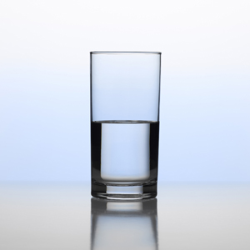
What is your outlook on life?

Slide 2
Optimist
You wake up ready to take on the day with a positive attitude.
You focus on your goals rather than worrying about things you cannot control.
You believe in yourself and treat yourself with respect.
You turn envy and jealousy into into catalysts for success.
You chose not to blame others for your own actions or in tough situations.

Slide 3
Most people are generally optimistic in life. Optimism is a form of positive thinking that includes the belief that you are responsible for your own happiness, and that more good things than bad will continue to happen to you. The best optimists believe that bad or negative events are rare occurrences and that it is not their fault when something bad happens but is due to something external.

Slide 4
Pessimist
The most extreme pessimist expects the worse case scenario
You downplay your successes
You see the problem before the solution
You can see the bigger picture, therefore are able to plan for the future better
You have a hard time trusting people right away

Slide 5
Is being a pessimist a bad thing…?
No. Generally speaking, you tend to see the challenges and difficulties of a situation before you see the bright side. Not that that's a bad thing; you're an expert at working through tricky situations and your tendency to predict and immediately fix problems makes you a great significant other, too. Your friends and family rely heavily on you when they need advice, and even though you see the dark before the dawn, you can usually manage to find your way to the daylight eventually.

Slide 6
We are not always just positive or negative…
Optimism and pessimism are two different outlooks on life that dictate how you deal with most situations and your expectations of the world. People tend to label themselves and others as either optimistic or pessimistic but to do so is overly simplistic. Optimism and pessimism can co-exist and vary depending on circumstances. For example you may have an optimistic outlook on life, but feel quite pessimistic about your job. This is why you shouldn't label yourself as either optimistic or pessimistic. Think of optimism as a sliding scale, one end being extremely optimistic and the other being very low on optimism. We all fit somewhere along this sliding scale and it tends to vary for different events in our lives.

Slide 7
There’s more than just positive and negative… Realist
You don’t see the world through any kind of filter (positive or negative)
You objectively point out flaws in situations
You see both sides of things
You see life as survival of the fittest
You are mature enough to realize life has its ups and downs

Slide 8
Idealist
You feel a lot of emotions all at once
You look for possibility everywhere
You empathize with people
You notice the symbolic meanings hidden in everyday things

