Slide 1
Gross Catholic Marianist LIFE Community Submitted by Mikaela VanMoorleghem vanmoorleghem@grosscatholic.org

Slide 2
All things being equal. They are not.
As first world consumers, we have tremendous power. What we collectively choose to buy or not buy, can change the course of life and history on this planet.
(RED) is that simple of an idea. And that powerful. Now you have a choice. There are (RED) credit cards, (RED) phones, (RED) shoes, (RED) fashion brands. And no, this does not mean they are all red in color although some are.
If you buy a (RED) product or sign up for a (RED) service, a (RED) company will give some of its profits to buy and distribute anti-retroviral medicine to our brothers and sisters dying of AIDS in Africa.
(RED) is not a charity, it is simply a business model. You buy (RED) stuff, we get the money, buy the pills and distribute them. They take the pills, stay alive and continue to take care of their families and contribute socially and economically in their communities.
If they don’t get the pills, they die. We don’t want them to die. We want to give them pills and we can. And you can. And it’s easy.

Slide 3
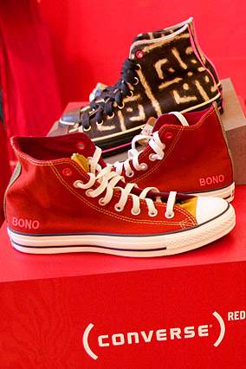
Product (RED) Participants:
CONVERSE

Slide 4
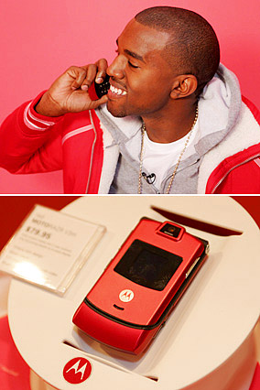
Motorola

Slide 5
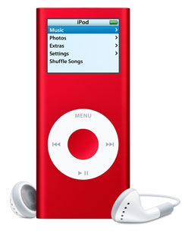
APPLE

Slide 6
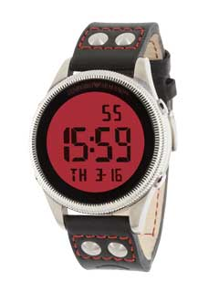
Armani

Slide 7
Armani

Slide 8
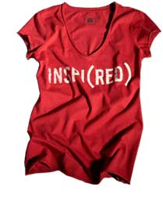
GAP

